Slide 1
Protocols to Build a High Performance Team https://liveingreatness.com/core-protocols/
Eric Zhang (Teams)
Notes:
Hello everyone, today I am really glad to introduce u to protocols to build a high performance team.
First question, why does building a high performance team matter to me?
As I began to work in Microsoft, especially Teams, I began to realize the importance of collaborating with other people and even other teams. Usually Microsoft projects have a lot of dependencies, this cannot be more true for Teams which is a hub for many many microsoft products, we need to interact with Skype, Office365, Azure… And Teams engineering staff is growing bigger and bigger. A lot of times the bottleneck of productivity is not on technical side but on people side. For example, my PR is blocked for month, I could not get the project assignments which motivates me enough, partner teams don’t respond…
Working in a high performance team will make everyone more productive and happier. The responsibility of building a high performance team lies not only in managers, but within everyone working together, no matter you are a developer, program manager, data scientist, or engineering manager. Everyone either help in building a high performance team or drag it down, conciously or unconsciously.

Slide 2
Can you say these things about your teams?
Can you say these things about your teams?
My projects effortlessly complete on schedule and in budget every time.
Every team I’ve ever been on has shared vision.
In meetings, we only ever do what will get results.
No one here blames “management”, or anyone else, if they don’t get what they want.
Everybody here shares their best ideas right away.
Ideas are immediately unanimously approved, improved, or rejected by the team.
Action on approved ideas begins immediately.
Conflict is always resolved swiftly and productively.
Such teams are called high performance teams.
Notes:
What defines a high performance team?
Here are a few characteristics including shared vision, no complaints, delivering on time, best ideas gets adopted, conflicts resolved swiftly.

Slide 3
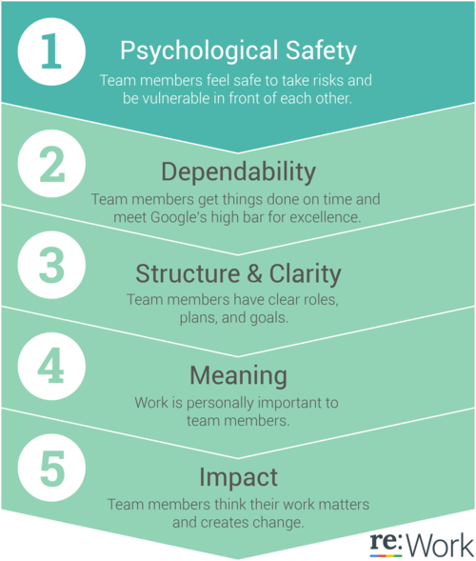
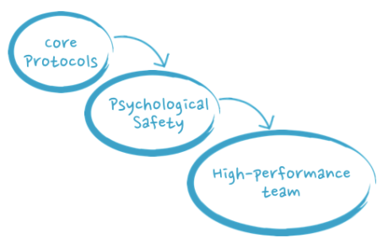
What matters to high performance team
“Psychological Safety is one thing that correlated most to high-performance” Google Aristotle Project
You will be OK with your teammates no matter what.
You are free to be yourself.
You can admit you don’t know something
You can ask for help
Safe to take risks without fear of embarrassment
Good science, then how?
Notes:
So what are the key elements of high-performance teams? Google has done the famous research on discovering that “Physchological safety” is the most correlated factor to high performance teams.
Psychological safety means that you are free to be yourself. If you don’t know something, acknowledge it. If you cannot do something on your own, ask for help. If you want to try something,
This is great science by Google. One thing Google does not answer is the skills to build high performance teams and that’s exactly what Core Protocols are proposed to address.

Slide 4
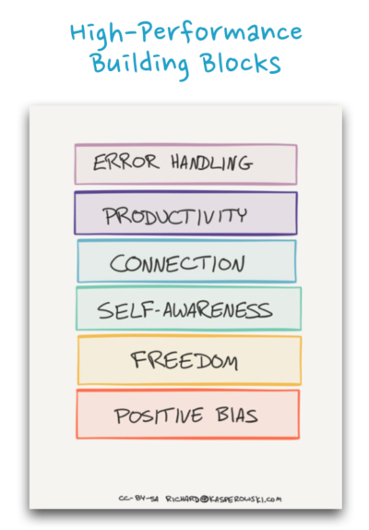
Core Stack of building blocks
When observing high performance teams, the author sees “love”
Or if you prefer, a consistent pattern of behaviors
They assume the best in one another’s intent
They want to know what each person is, what’s going on for them
They’re interested in another’s work and activities, fascinated and curious
They’re interested in what motivates and inspires one another, what each person wants out of life, and their current focus
They’re secure enough with each other to assert their opinions, question one another, and hear each other out.
They are aligned toward common goals as a team, and not competing each other as individuals – no points-scoring, zero-sum thinking, or back-stabbing
A stack of consistent behaviors
Notes:
The author of Core Protocols observed a lot of high performance teams and did lot of research, he categoreis the high performance team behaviors into a stack of build blocks.

Slide 5

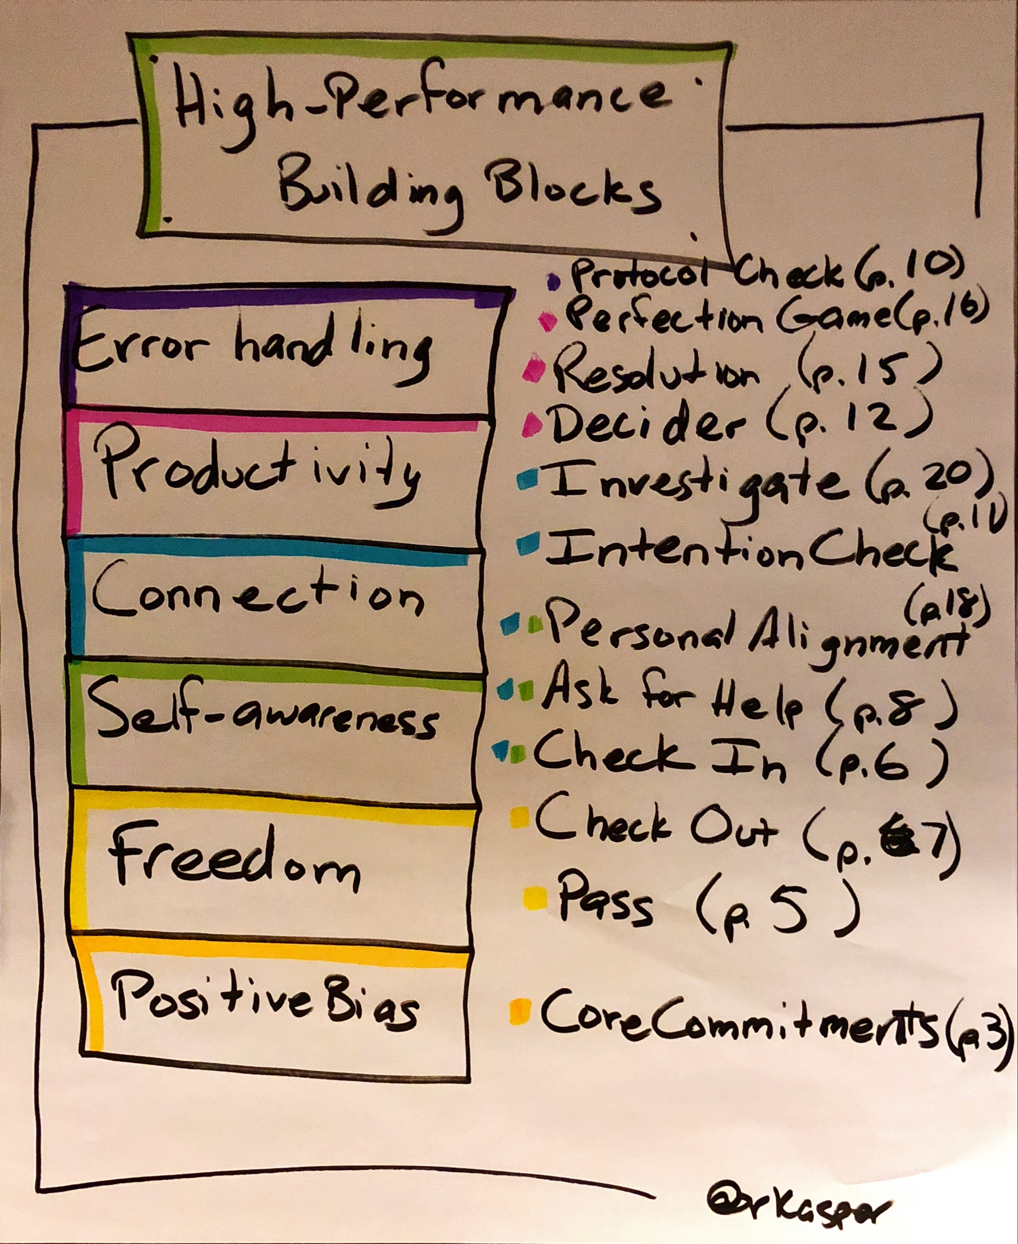
Core Protocols
Use an example protocol from each domain to demonstrate:
Positive Bias: Core Commitments
Self-awareness: Check In
Productivity: Perfection Game
Connection: Personal Alignment
Freedom: Check out
Notes:
Here on the right side of the screen is the building blocks for high performance teams. There are six blocks in total and each block contains several protocols.
Among these six blocks, each block builds on top of another one.
This is actually a condensed version of the Core protocols with 12 protocols in total. If you look for a complete reference, there will be around 40 protocols and anti-protocols in total. But among all of them, these 12 are the cornerstone for all other protocols.

Slide 6
Positive Bias: Core Commitments
I commit to engage when present.
To know and disclose
what I want,
what I think, and
what I feel.
To always seek effective help.
To decline to offer and refuse to accept incoherent emotional transmissions.
When I have or hear a better idea than the currently prevailing idea, I will immediately either
propose it for decisive acceptance or rejection, and/or
explicitly seek its improvement.
I will personally support the best idea
regardless of its source,
however much I hope an even better idea may later arise, and
when I have no superior alternative idea.
I will seek to perceive more than I seek to be perceived.
I will use teams, especially when undertaking difficult tasks.
Notes:
First, let’s take a look at Positive Bias.
There are a lot of commmitments and we could not look through them one by one.

Slide 7
Positive Bias Protocol: Core Commitments
I will speak always and only when I believe it will improve the general results/effort ratio.
I will offer and accept only rational, results-oriented behavior and communication.
I will disengage from less productive situations
When I cannot keep these commitments,
When it is more important that I engage elsewhere.
I will do now what must be done eventually and can effectively be done now.
I will seek to move forward toward a particular goal, by biasing my behavior toward action.
I will use the Core Protocols (or better) when applicable.
I will offer and accept timely and proper use of the Protocol Check protocol without prejudice.
I will neither harm—nor tolerate the harming of—anyone for his or her fidelity to these commitments.
I will never do anything dumb on purpose.

Slide 8
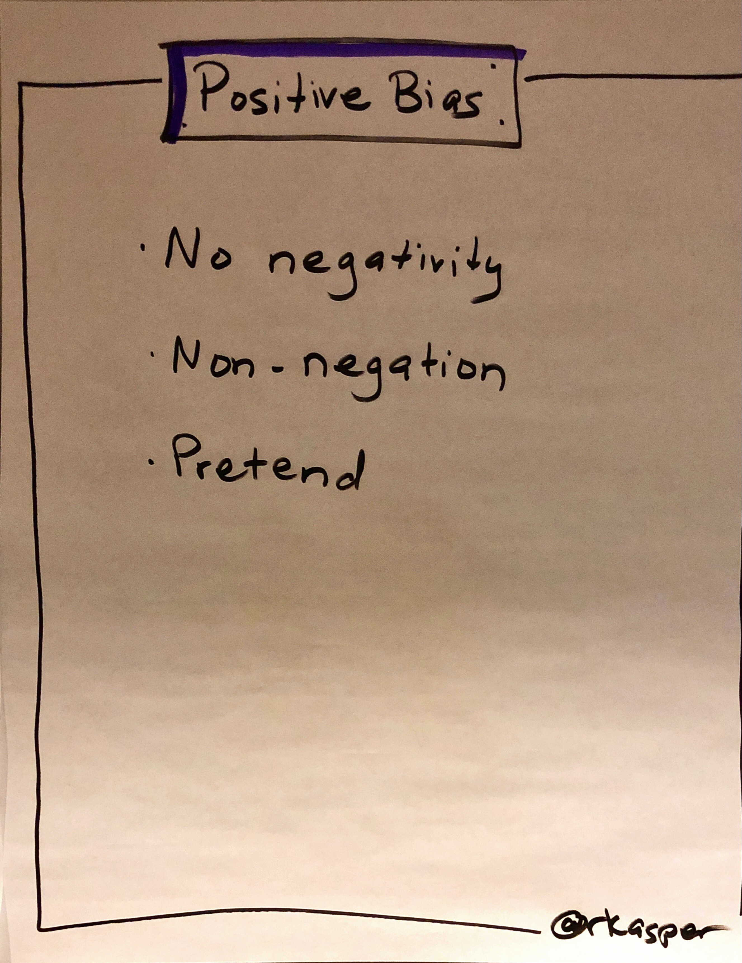
Positive Bias: Core Commitments
No negativity
Pretend it’s a good idea
Use “Yes” to build safety.
Use “and” to add on to each other’s idea. Compare the effects of “Yes, And …” vs “Yes, but …”
Notes:
Among all of them, the most important is no negativity. Team members always pretend others have good idea and make your teammates look great.

Slide 9
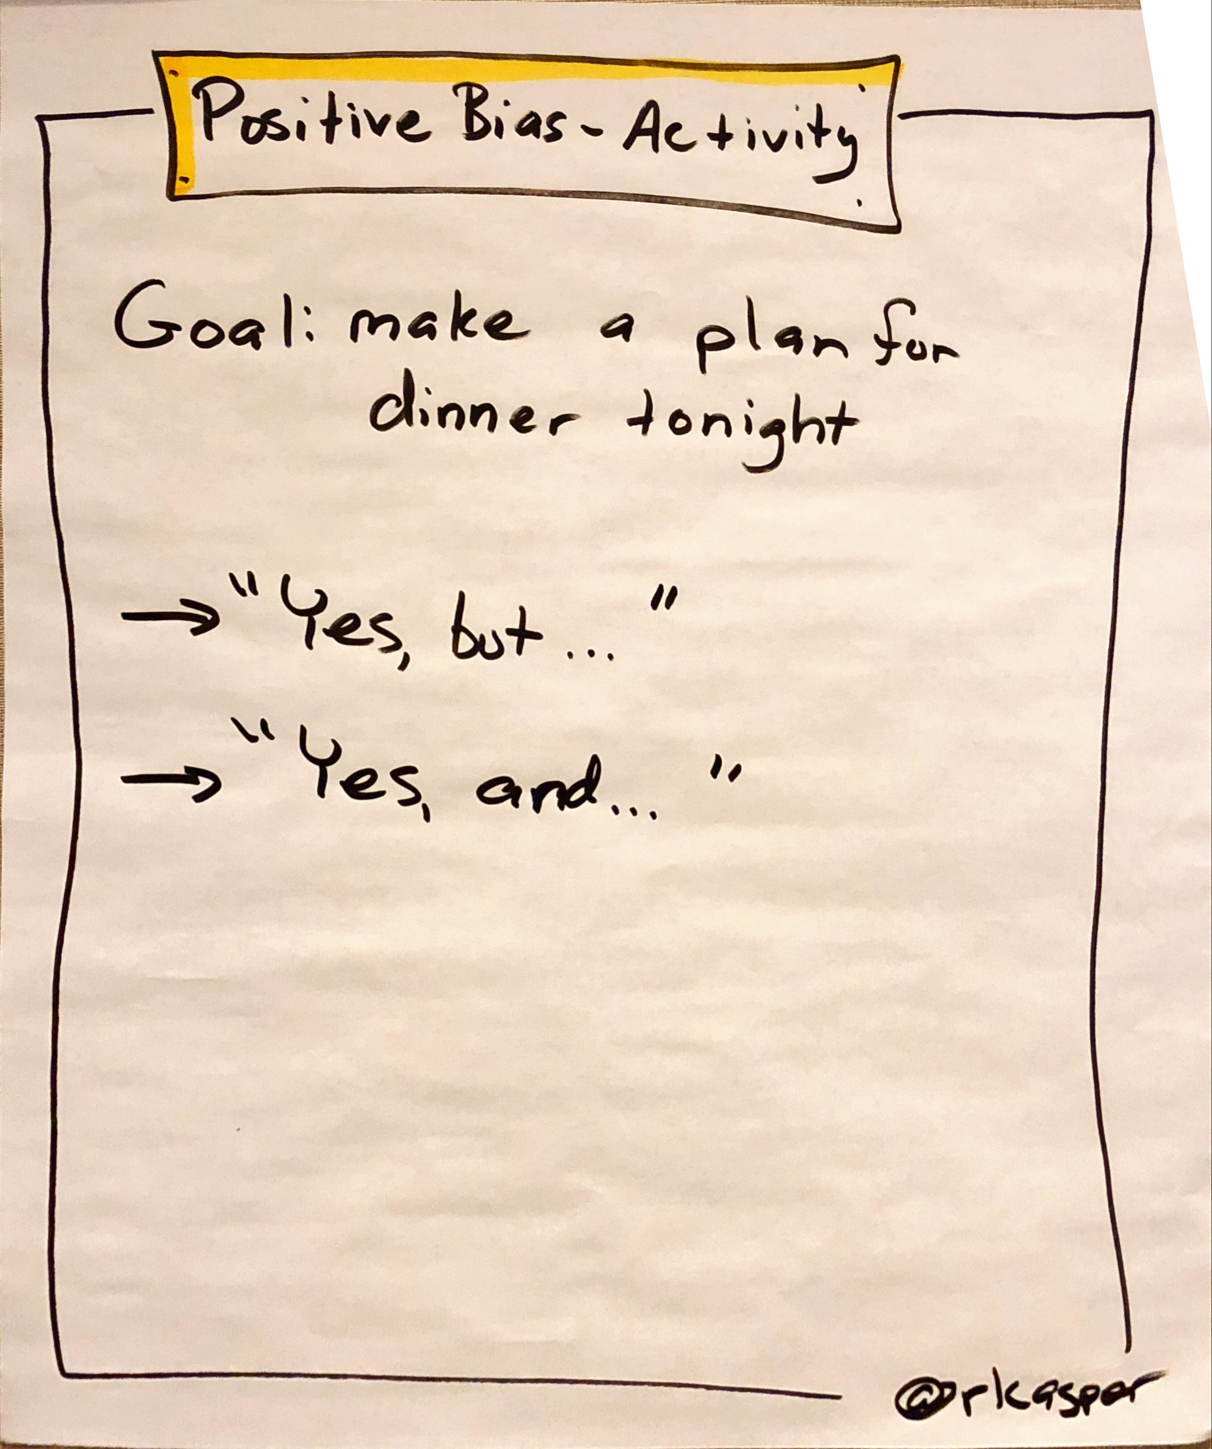
Positive Bias: Core Commitments
Example with “Yes, and”
A: what about going to Panda Express tonight in Bellevue Square?
B: Yes, and we could get a coffee on our way back at StarBucks
A: Yes, and I have some StarBucks coupons I could share with you
…..
Example with “Yes, but”
A: what about going to Panda Express tonight in Bellevue Square?
B: Yes, but I need to fix some urgent bugs before the end of the day
A: Yes, but you could do that after we come back from the lunch
…..
Notes:
We can use an example Game to visualize what positive bias mean.
Suppose that A suggests that we plan for a dinner tonight to B.
We have one experimental group responding to each other beginning with “Yes, and” and another experimental group responding to each other beginning with “yes, but”.
Along the time we could see the atmoshpere change in these two experimental groups. People in “Yes, and” experimental group achieve more results and the second experimental group could not deliver anything.

Slide 10
Self-awareness: Check In Protocol
When to use: Begin any individual or group interactions
Steps:
Speaker says: “I feel [one or more of MAD, SAD, GLAD, AFRAID].” Speaker may provide a brief explanation. Or if others have already checked in, the speaker may say “I pass”. (See Pass Protocol)
Speaker says “I’m in. This signifies that speaker intends to behave according to the core commitments”
Listeners respond “Welcome”
Core commitments:
State feelings without qualification
State feelings only as they pertain to yourself
Be silent during another’s check in.
Notes:
Among all of the Self-awareness Protocols, what resonates most with me is the Check In Protocol.

Slide 11
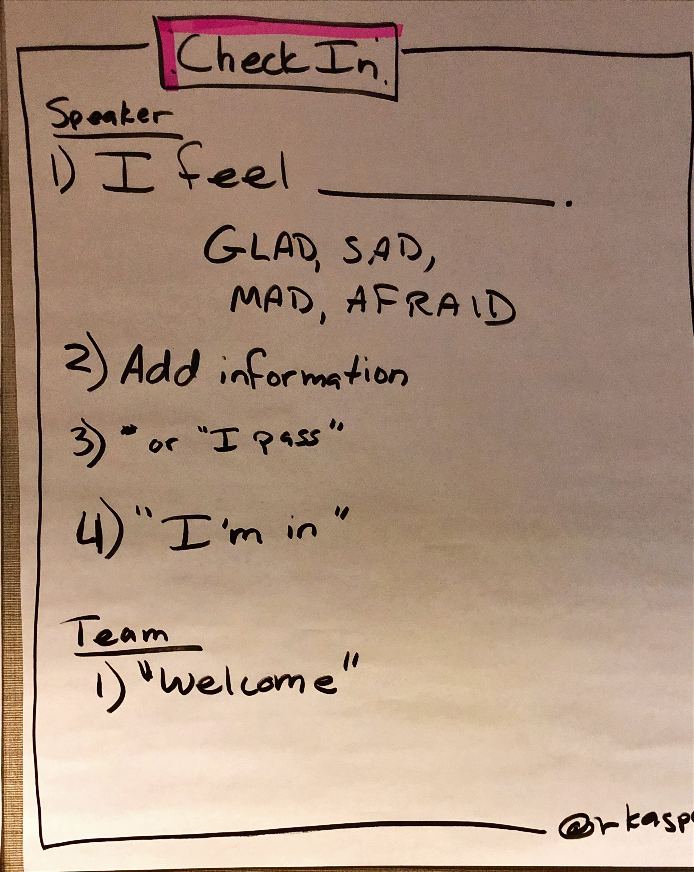
Self-awareness: Check In Protocol
All emotions are expressed through combinations of “MAD, SAD, GLAD, or AFRAID”
For example, excited may be a combination of GLAD and AFRAID
Check in as deeply as possible. Check in with one or two emotions in the norm
Do not use anything to diminish your emotional state such as “a little”
Notes:
The Check in protocol works like this
A large number of people believe that expressing emotion at work is inappropriate or unprofessional. Actually when emotions are expressed indirectly at work, the distance between people increases. These emotional self-repression reduces both team efficiency and product quality because you are less present than you could be.
The check in pattern undermines all that. It increases your awareness of emotions and express them directly, efficiently and productivley in a team environment.
All emotions are expressed as a combination of four basic emotions “MAD, SAD, GLAD, AFRAID”. For example, excited can be expressed as a combination of GLAD and AFRAID.

Slide 12
Self-awareness/Connection: Personal Alignment Protocol
When to use: Use it to discover, articulate and achieve what you want. The quality of your alignment will be the quality of your results.
Steps:
Want. Answer the question: “What specifically do I want?”
Block. Ask yourself, “What is blocking me from having what I want?”
Virtue. Figure out what would remove this block by asking yourself “What virtue—if I had it— would shatter this block of mine?”
Shift. Pretend the virtue you identified is actually what you want.
Again. Repeat steps 2 to 4 until this process consistently yields a virtue that is powerful enough to shatter your blocks and get you what you originally thought you wanted.
Done. Now write down a personal alignment statement in the form “I want [virtue].” For example, “I want courage.”
Signal/Response/Assignment. Create a signal to let others know when you are practicing your alignment, and provide a response they can give you to demonstrate support. For example, “When I say/do ‘X,’ will you say/do ‘Y’?” Optionally, turn it into an assignment by saying you will do X a certain number of times per day, where X equals an activity that requires you to practice living your alignment.
Evidence. Write, in specific and measurable terms, the long-term evidence of practicing this alignment.
Help. Ask each member of your group for help. They help by giving the response you would like when you give your signal that you are practicing your alignment.
Notes:
The Personal Alignment protocol helps you penetrate deeply into your desires and find what’s blocking you from getting what you want. Use it to discover, articulate, and achieve what you want. The quality of your alignment will be equal to the quality of your results.

Slide 13
Self-awareness/Connection: Personal Alignment Protocol
Commitments
Identify an alignment that will result in your personal change and require no change from any other person.
Identify blocks and wants that are specific and personal.
Identify blocks that, if solved, would radically increase your effectiveness in life, work, and play.
Choose a virtue that is about you and preferably one word long. For example: integrity, passion, self-care, peace, fun.
Ask for help from people who know you and/or know alignments.
Identify evidence that is measurable by an objective third party.

Slide 14
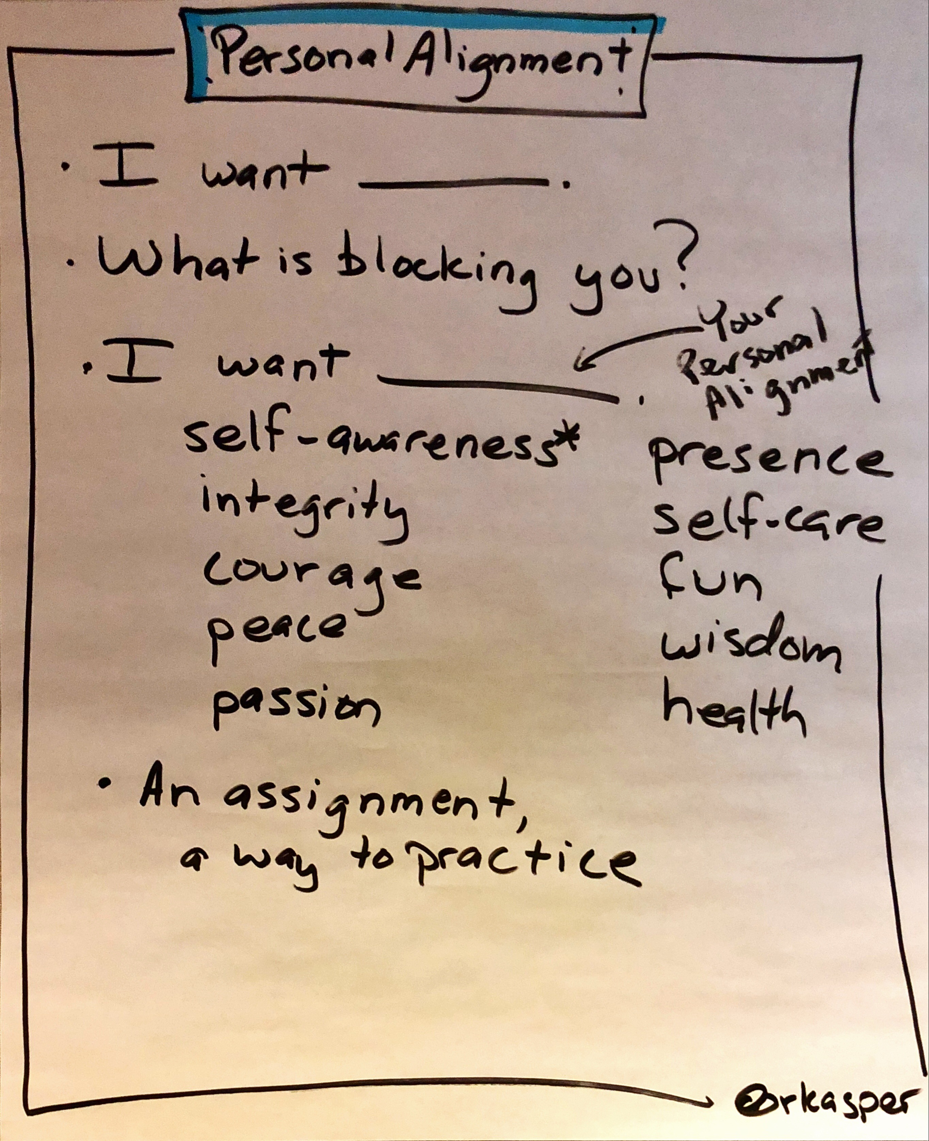
Self-awareness/Connection: Personal Alignment Protocol
Notes
The most popular personal alignments are “I want (Integrity, Courage, Passion, Peace, Self-Awareness or Self-Care)”. If you are struggling with figuring out what you want, adopt the alignment “I want self-awareness.” There is no case where increased self-awareness would not be beneficial.
Ideally, identify both immediate and long-term evidence of your alignment. Write down results that start now (or very soon), as well as results you’ll see at least five or more years in the future.
As a default signal, tell your teammates or others who are close to you that you are working on your alignment when you are practicing it. If they don’t know the protocol, just tell them what virtue you are working on and ask for their help.
When members of a team are completing their personal alignments together (asking each other for help), the final step of the process is most powerful if done as a ceremony.
Notes:
Why does personal alignment really matters?
If I don’t know what I want from this team/project, then I will not be motivated. Unless personal alignment happens, team alignment will not happen.
The personal alignment protocol gives you a way to think deeply about what you really want. For example, it only allows you to choose from certain common alignments such as self-awareness, integrity, courage, peace, passion. It won’t allow you to choose from something such as “confidence” because it isn’t clear. Another example, patient is not an alignment because alignment is limited to what you do for yourself, not others.
We could look at an example of alignment. I feel so much powerful and clear after aligning myself.

Slide 15
Self-awareness/Connection: Personal Alignment Protocol
Want. Answer the question: “What specifically do I want?” I want to work on some big projects
Block. Ask yourself, “What is blocking me from having what I want?” My manager worries my skill is not well-rounded and could not deliver on time.
Virtue. Figure out what would remove this block by asking yourself “What virtue—if I had it— would shatter this block of mine?” Passion would shatter this block of mine.
Shift. Pretend the virtue you identified is actually what you want.
Again. Repeat steps 2 to 4 until this process consistently yields a virtue that is powerful enough to shatter your blocks and get you what you originally thought you wanted.
Done. Now write down a personal alignment statement in the form “I want [virtue].” For example, “I want courage.” I want passion
Signal/Response/Assignment. Create a signal to let others know when you are practicing your alignment, and provide a response they can give you to demonstrate support. For example, “When I say/do ‘X,’ will you say/do ‘Y’?” When I say “I delivered on time/learnt new skills”/share new skills with you I learnt, you say “Go Eric”
Evidence. Write, in specific and measurable terms, the long-term evidence of practicing this alignment.
“Write an email to my manager on how many tasks I deliver on time and what new skills learnt”
Notes:
At least after this alignment, I feel more powerful.

Slide 16
Freedom: Pass Protocol
The Pass protocol is how you decline to participate in something. Use it anytime you don’t want to participate in an activity.
Steps
When you’ve decided not to participate, say “I pass.”
Unpass any time you desire. Unpass as soon as you know you want to participate again by saying “I unpass.”
Commitments
Hold reasons for passing private.
Pass on something as soon as you are aware you are going to pass.
Respect the right of others to pass without explanation.
Support those who pass by not discussing them or their pass.
Do not judge, shame, hassle, interrogate or punish anyone who passes.
Notes:
I resonate deeply with this principal because it give me freedom to pass activities which I won’t be engaged and contributing.
For example, sometimes scrums are not structured in a correct way and become too long for about 20-30 minutes. There are a lot of irrelevant information during the scrum and I don’t really want to waste my time there. And one great thing about this protocol is that I could hold passing reasons for private. For example, in a 10 person team 20/30 minutes scrum, although most of the scrum information is not relevant to me, but it will be relevant to my manager. It will be a lot of pressure for me to explain such things to my manager every day.

Slide 17
Freedom: Pass Protocol
Commitments
Return as soon as you can and are able to keep the Core Commitments.
Return and Check In without unduly calling attention to your return.
Do not judge, shame, hassle, interrogate, or punish anyone who checks out.
Notes
When you Check Out do it as calmly and gracefully as possible so as to cause minimal disruption to others.
Check Out if your emotional state is hindering your success, if your receptivity to new information is too low, or if you do not know what you want.
Check Out is an admission that you are unable to contribute at the present time.

Slide 18
Productivity: Perfection Game Protocol
The Perfection Game protocol will support you in your desire to aggregate the best ideas. Use it whenever you desire to improve something you’ve created.
Steps
Perfectee performs an act or presents an object for perfection, optionally saying “Begin” and “End” to notify the Perfector of the start and end of the performance.
Perfector rates the value of the performance or object on a scale of 1 to 10 based on how much value the Perfector believes he or she can add.
Perfector says “What I liked about the performance or object was X,” and proceeds to list the qualities of the object the Perfector thought were of high quality or should be amplified.
Perfector offers the improvements to the performance or object required for it to be rated a 10 by saying “To make it a ten, you would have to do X.”
Notes:
Then we come to the productivity protocol. I love this protocol the most among all protocols. Do you know why? Because each time my manager gives me feedback, my heart breaks.
Although usually my manager will say a lot of good words to me before pointing out the area which needs my improvement, but unconsciously I always feel that all the previous good words are preparation for the final two bad words.
In addition, this week of giving feedback forces the feedback giver to think from the perspective of the person being evaluated. Suppose he gives you a score of 5, then he needs to come up with ideas on how to make it 10, which is twice as good as it is now.
Over the time, even my manager does not know how to give feedback to me and this thing becomes a deadlock. I think the reason is that the feedback is not quantified and the critics are not expressed in a framework which make people feel relieved.

Slide 19
Productivity: Perfection Game Protocol
Commitments
Accept perfecting without argument.
Give only positive comments: what you like and what it would take to “give it a 10.”
Abstain from mentioning what you don’t like or being negative in other ways.
Withhold points only if you can think of improvements.
Use ratings that reflect a scale of improvement rather than a scale of how much you liked the object.
If you cannot say something you liked about the object or specifically say how to make the object better, you must give it a 10.

Slide 20
Productivity: Perfection Game Protocol
Notes
A rating of 10 means you are unable to add value, and a rating of 5 means you will specifically describe how to make the object at least twice as good.
The important information to transmit in the Perfection Game protocol improves the performance or object. For example, “The ideal sound of a finger snap for me is one that is crisp, has sufficient volume, and startles me somewhat. To get a 10, you would have to increase your crispness.”
As a perfectee, you may only ask questions to clarify or gather more information for improvement. If you disagree with the ideas given to you, simply don’t include them.

Slide 21
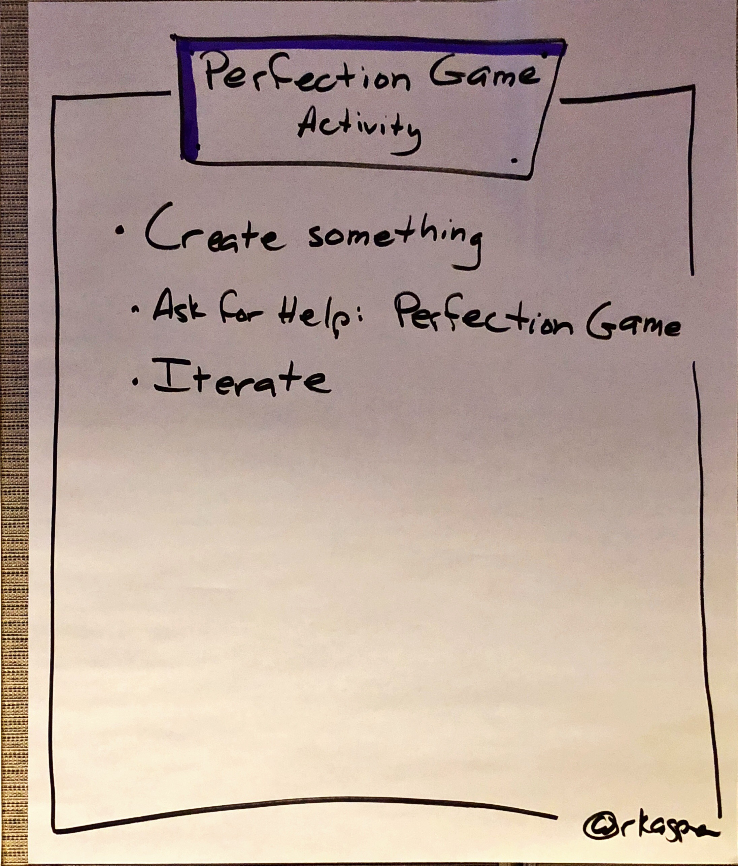
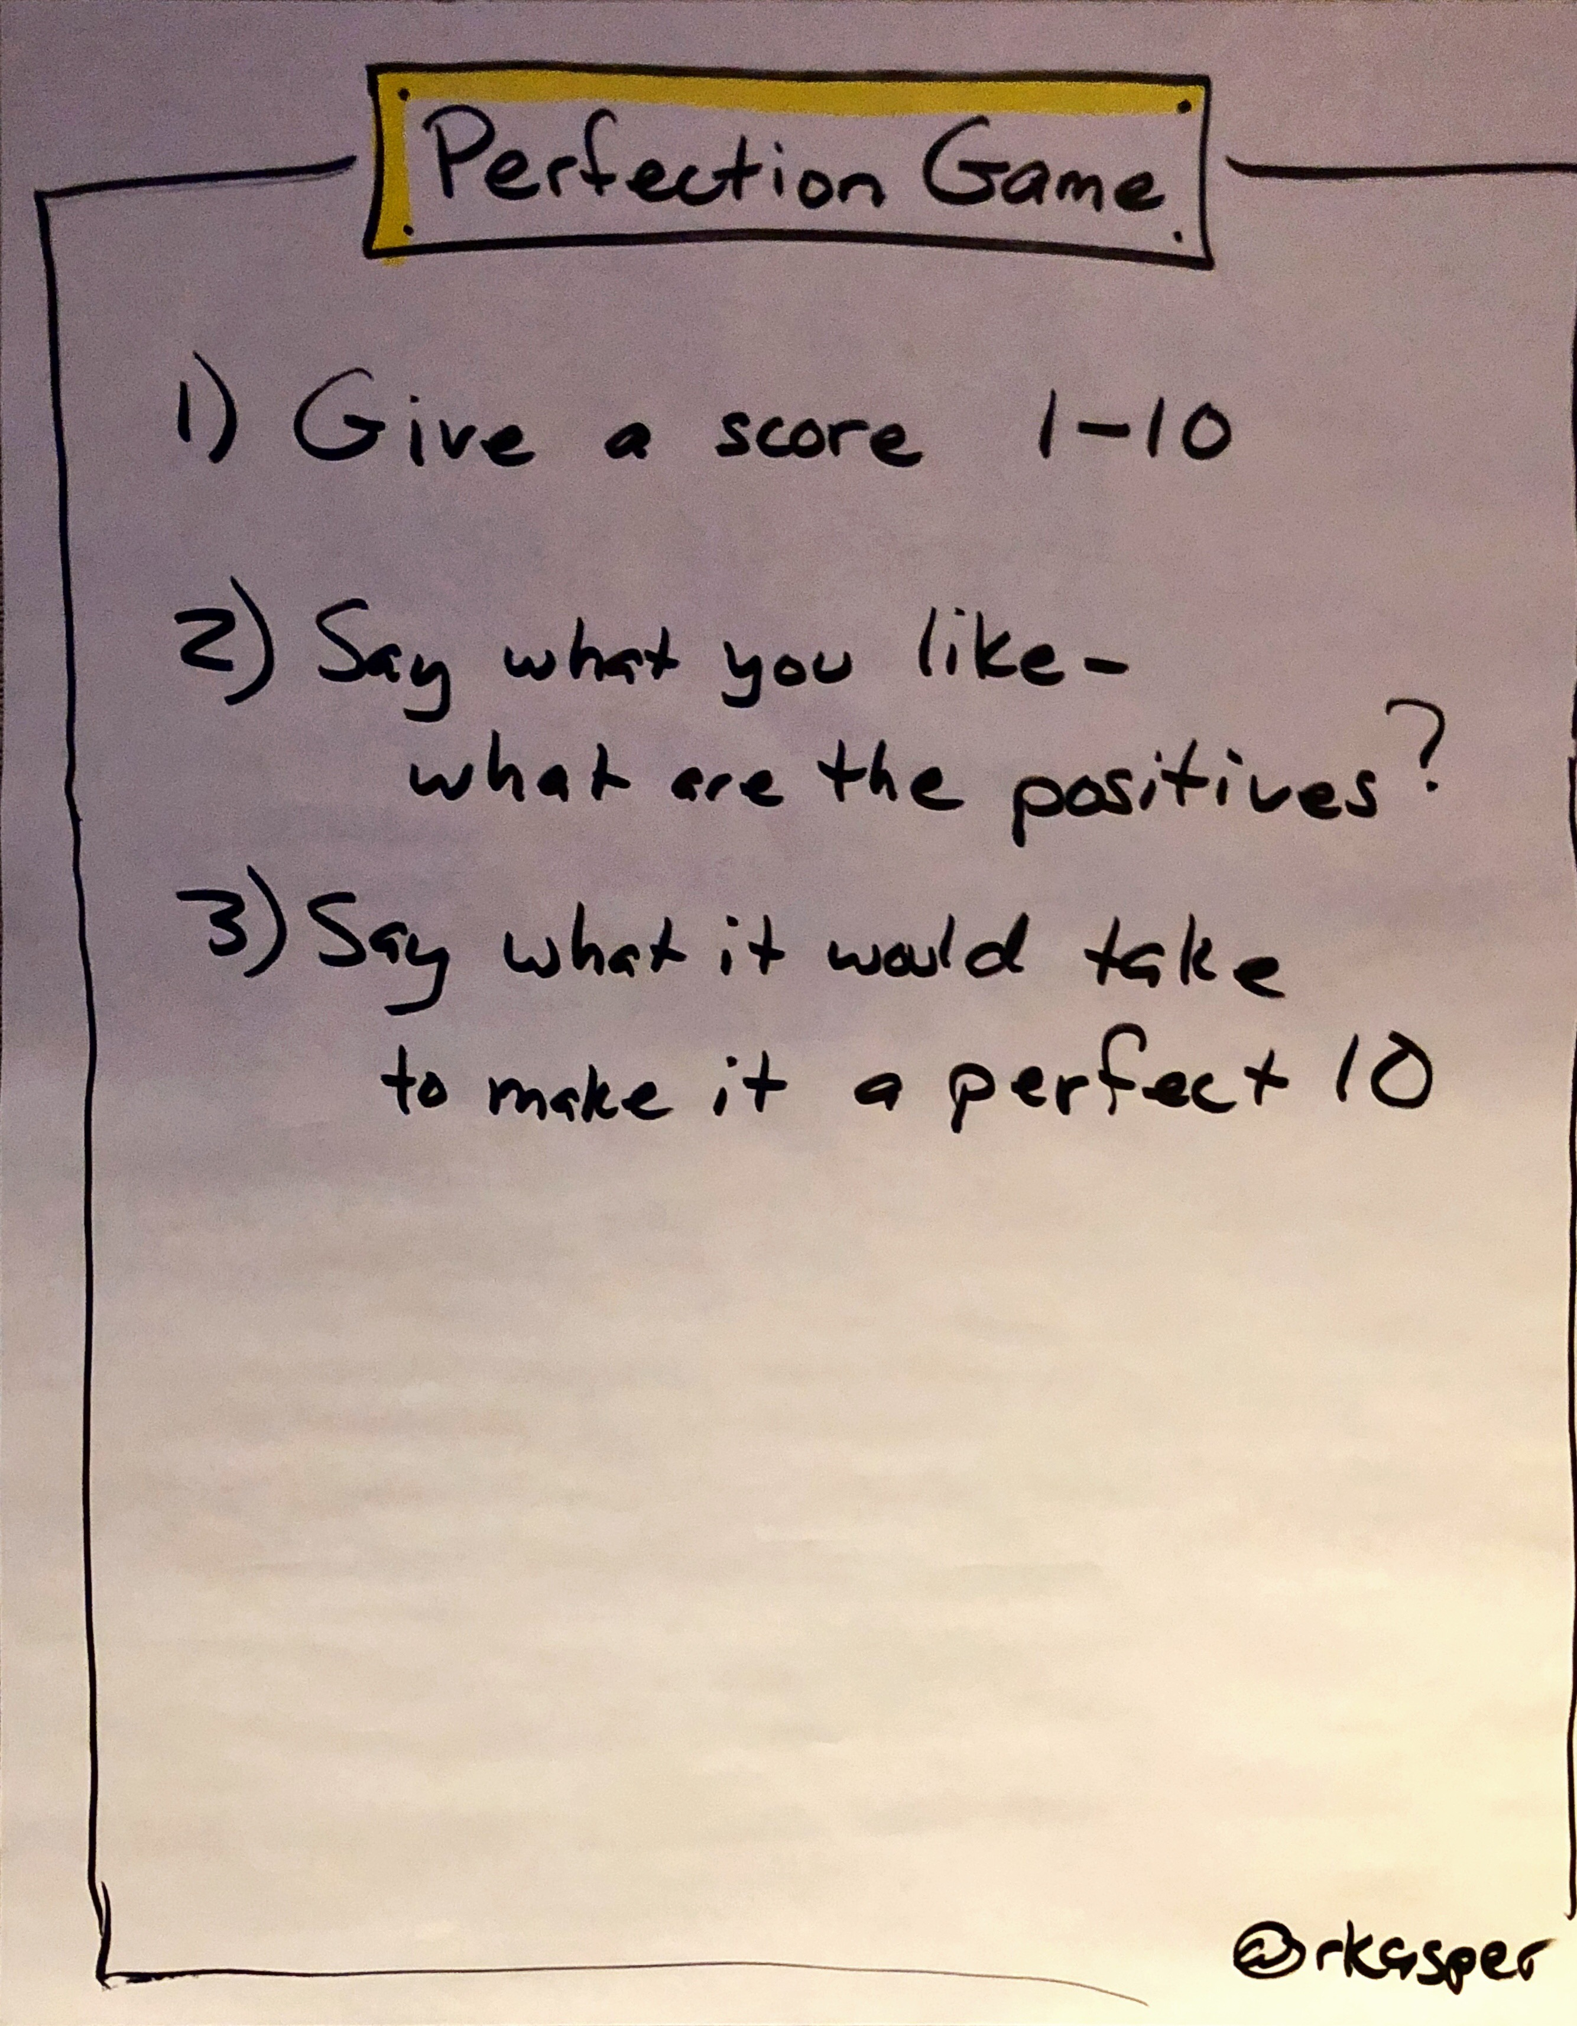
Productivity: Perfection Game Protocol

Slide 22
Productivity: Perfection Game Protocol
Manager feeback:
Eric you did a great job in launching AuthSvc GccH. You delivered everything on time and without any bugs.
You should engage partner services earlier so that we won’t be blocked by them in the future.
Manager feedback:
I would give you a 9 out of 10 for launching AuthSvc in GccH region. You delivered everything one thing on time and without bugs.
If you could give partner services an earlier head up, I will give you a 10,

Slide 23
Error Handling: Protocol Check
Use Protocol Check when you believe a protocol is being used incorrectly in any way or when a Core Commitment is being broken.
Steps
Say “Protocol Check.”
If you know the correct use of the protocol, state it. If you don’t, ask for help.
Commitments
Say “Protocol Check” as soon as you become aware of the incorrect use of a protocol, or of a broken Core Commitment. Do this regardless of the current activity.
Be supportive of anyone using Protocol Check.
Do not shame or punish anyone using Protocol Check.
Ask for help as soon as you realize you are unsure of the correct protocol use.

Slide 24
Other Details
https://liveingreatness.com/
Book “Software for Your Head”

